Slide 1



Presentation V
Integrating Sphere Required list
Thu Ta Zaw
2415121095

Slide 2

Optical properties measurement system
Setup
Common features : ▪ A white reflective surface with uniform, high reflectivity. ▪ In the unlikely event that the diffusing surface becomes contaminated or deteriorates, it can be restored and maintained. ▪ A variety of light sources can be used by changing the integrating sphere accessories, such as the support stand and socket. ▪ The size and shape of the integrating sphere can be freely designed to suit the inspection and sorting equipment. Light-resistant type : ▪ The white reflective surface is created using 100% barium sulfate without using any binders (patented). ▪ It has mechanical strength that can withstand machine vibrations, etc. ▪ It has excellent robustness, long-term stability, and weather resistance, even in production site environments.Working principle
From company - 3-inch integrating sphere for transmission/reflection measurements - SiPD sensor (light output confirmed using PC software) - Reference white plateIn this configuration, the SiPD sensor is fixed and will not be removed. The connection will be switched on the laser side for transmission and reflection.
Could you please confirm whether it is possible to route the laser light using an SMA fiber or similar?
It is also possible to configure a 2-inch integrating sphere for transmission and reflection separately.
Fig. Detection of light reflection using integrating sphere
Fig. Ophir’s general-purpose sphere

Slide 3
Required List
NAME | PRICE
2-inch General-purpose Integrating Sphere [NIS-002-03A]
Sphere cover and mouting for laser
Mounting for detector
Mounting
Sample Holder
Baffle [light blocker]
850 nm laser light
SiPD sensor
Spectrometer
Optical Fiber
Raspberry Pi 5 | N/A
GeeekPi Metal Case and N04 PCIe M.2 Key-M NVMe SSD PCIe Peripheral Board for Raspberry Pi 5 (Metal Case & Expansion Board & Active Cooling Fan) | 4,099 Yen
ElectroCookie 256GB NVMe SSD for Raspberry Pi 5 – SK OEM BC901 (2242 Size, PCIe Gen4 x4) | 4,399 Yen
Freenove 7-inch Touchscreen Monitor for Raspberry Pi 5, 4, B, 3, B+, A+, 800x480 Pixel IPS Display, 5-Point Touch Capacitive Screen, MIPI DSI Port with No Drivers | 7,280 Yen

Slide 4
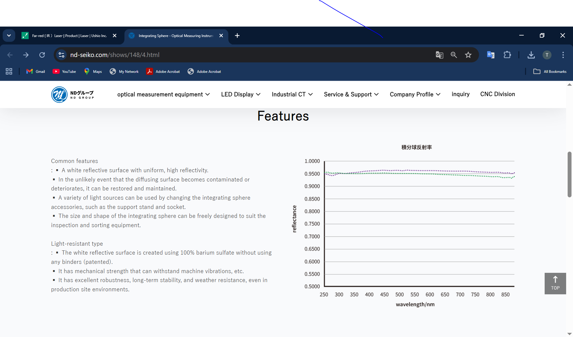
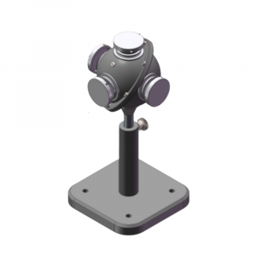
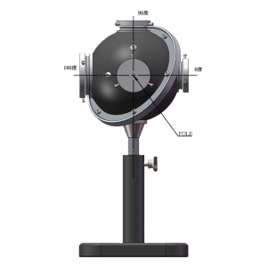
2-inch General-purpose Integrating Sphere [NIS-002-03A]
Optical properties measurement system
Background
Common features : ▪ A white reflective surface with uniform, high reflectivity. ▪ In the unlikely event that the diffusing surface becomes contaminated or deteriorates, it can be restored and maintained. ▪ A variety of light sources can be used by changing the integrating sphere accessories, such as the support stand and socket. ▪ The size and shape of the integrating sphere can be freely designed to suit the inspection and sorting equipment. Light-resistant type : ▪ The white reflective surface is created using 100% barium sulfate without using any binders (patented). ▪ It has mechanical strength that can withstand machine vibrations, etc. ▪ It has excellent robustness, long-term stability, and weather resistance, even in production site environments.Working principle
From company - 3-inch integrating sphere for transmission/reflection measurements - SiPD sensor (light output confirmed using PC software) - Reference white plateIn this configuration, the SiPD sensor is fixed and will not be removed. The connection will be switched on the laser side for transmission and reflection.
Could you please confirm whether it is possible to route the laser light using an SMA fiber or similar?
It is also possible to configure a 2-inch integrating sphere for transmission and reflection separately.
Fig. Detection of light reflection using integrating sphere
Fig. Ophir’s general-purpose sphere

Slide 5
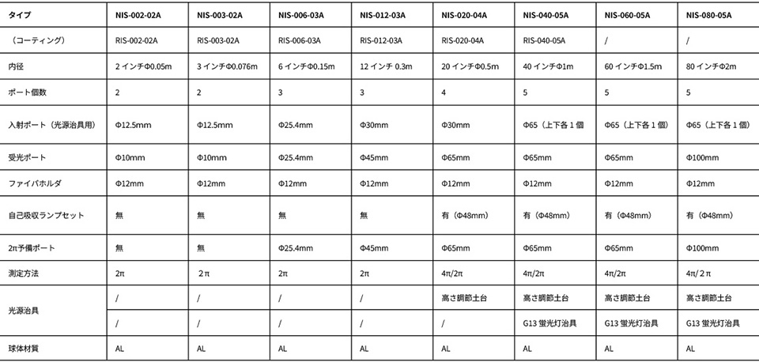
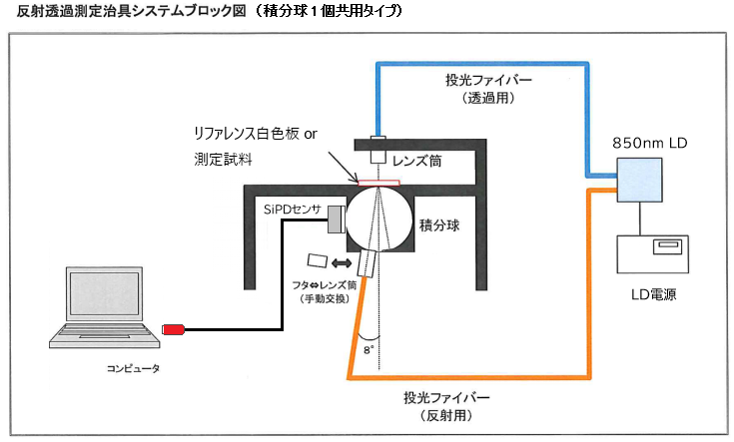
Optical properties measurement system
Background
Common features : ▪ A white reflective surface with uniform, high reflectivity. ▪ In the unlikely event that the diffusing surface becomes contaminated or deteriorates, it can be restored and maintained. ▪ A variety of light sources can be used by changing the integrating sphere accessories, such as the support stand and socket. ▪ The size and shape of the integrating sphere can be freely designed to suit the inspection and sorting equipment. Light-resistant type : ▪ The white reflective surface is created using 100% barium sulfate without using any binders (patented). ▪ It has mechanical strength that can withstand machine vibrations, etc. ▪ It has excellent robustness, long-term stability, and weather resistance, even in production site environments.Working principle
From company - 3-inch integrating sphere for transmission/reflection measurements - SiPD sensor (light output confirmed using PC software) - Reference white plateIn this configuration, the SiPD sensor is fixed and will not be removed. The connection will be switched on the laser side for transmission and reflection.
Could you please confirm whether it is possible to route the laser light using an SMA fiber or similar?
It is also possible to configure a 2-inch integrating sphere for transmission and reflection separately.
Fig. Detection of light reflection using integrating sphere
Fig. Ophir’s general-purpose sphere

Slide 6
Optical properties measurement system
Setup
Common features : ▪ A white reflective surface with uniform, high reflectivity. ▪ In the unlikely event that the diffusing surface becomes contaminated or deteriorates, it can be restored and maintained. ▪ A variety of light sources can be used by changing the integrating sphere accessories, such as the support stand and socket. ▪ The size and shape of the integrating sphere can be freely designed to suit the inspection and sorting equipment. Light-resistant type : ▪ The white reflective surface is created using 100% barium sulfate without using any binders (patented). ▪ It has mechanical strength that can withstand machine vibrations, etc. ▪ It has excellent robustness, long-term stability, and weather resistance, even in production site environments.Working principle
From company - 3-inch integrating sphere for transmission/reflection measurements - SiPD sensor (light output confirmed using PC software) - Reference white plateIn this configuration, the SiPD sensor is fixed and will not be removed. The connection will be switched on the laser side for transmission and reflection.
Could you please confirm whether it is possible to route the laser light using an SMA fiber or similar?
It is also possible to configure a 2-inch integrating sphere for transmission and reflection separately.
Fig. Detection of light reflection using integrating sphere
Fig. Ophir’s general-purpose sphere

Slide 7
The End
THANK YOU FOR LISTENING
Thu Ta Zaw
2415121095

